Slide 1

Cornfield 1959

Slide 2
Bross 1966
Cornfield 1959

Slide 3
Schlesselman 1978
Bross 1966
Cornfield 1959

Slide 4
Rosenbaum &
Rubin 1983
Schlesselman 1978
Bross 1966
Cornfield 1959

Slide 5
Lin 1993
Rosenbaum &
Rubin 1983
Schlesselman 1978
Bross 1966
Cornfield 1959

Slide 6
Ding &
VanderWeele
2016
Lin 1993
Rosenbaum &
Rubin 1983
Schlesselman 1978
Bross 1966
Cornfield 1959

Slide 7
Tipping Point
Analyses

Slide 8
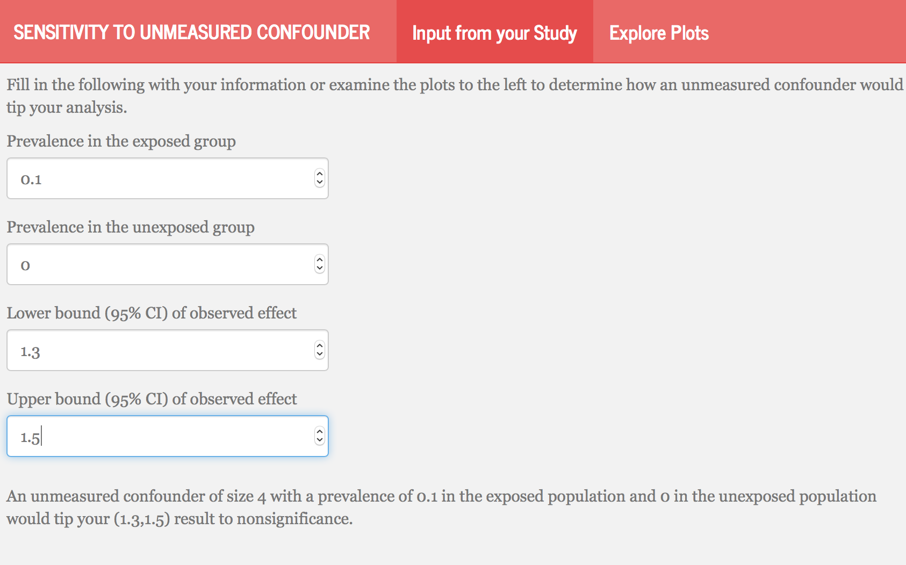

Slide 9
Unmeasured Confounder
Exposure
Outcome

